Slide 1
AISDC Meeting
2024-08-22
Actionable Data from Sensor to Data Center

Slide 2
Agenda
News?
Multi-channel Time Series at the Edge
Real-time Machine Learning for Tiled Detectors
SNL Expansion
In-situ HEDM
Framework for Rapid Model Retraining - FRMR
Other business
Link to Meeting Minutes

Slide 3
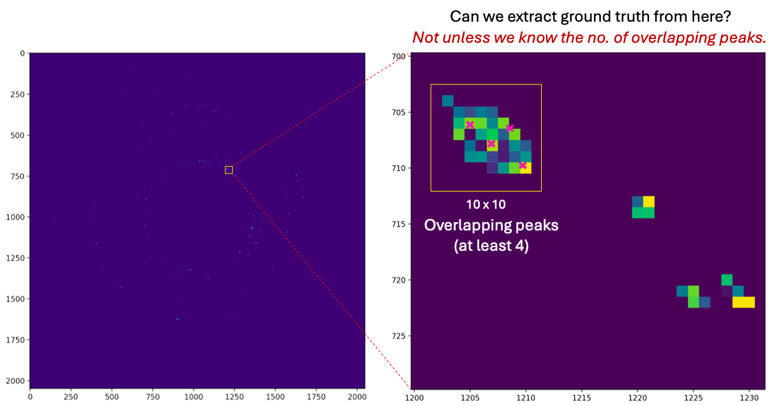
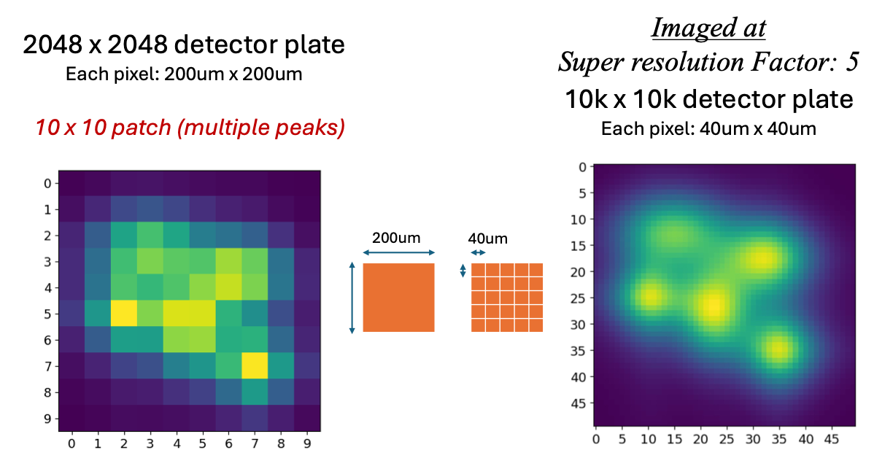
HEDM : Detecting overlapping peaks
Two key problems:
  Cannot extract reliable ground truth from experimental data
  Resolution is not sufficient for reliable peak deconvolution

Slide 4
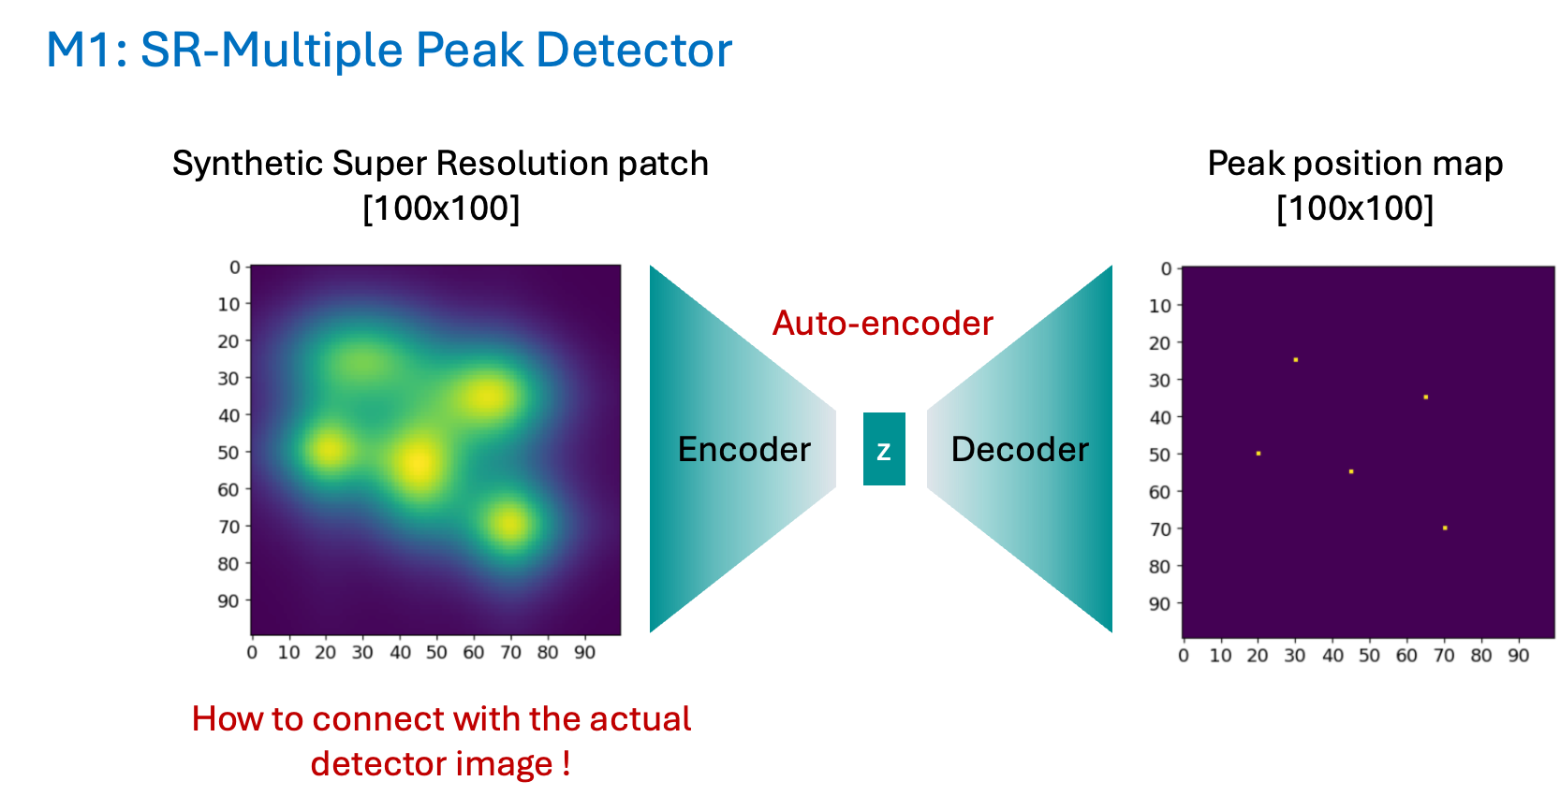
HEDM : Detecting overlapping peaks

Slide 5
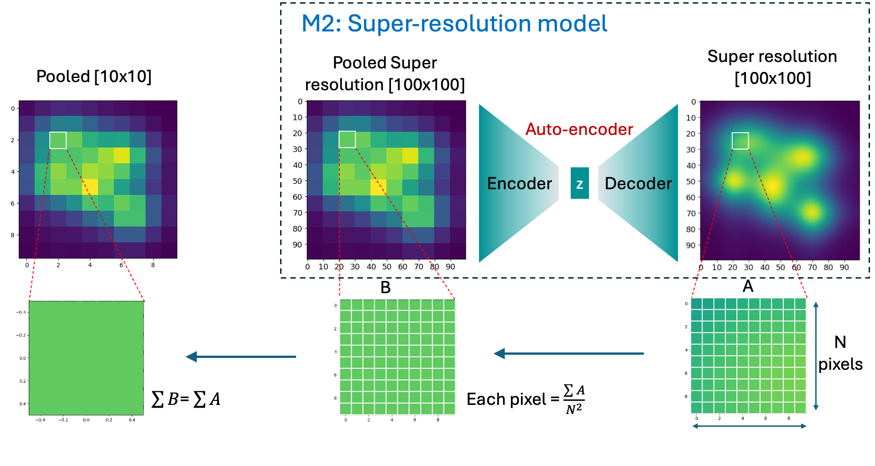
HEDM : Detecting overlapping peaks

Slide 6
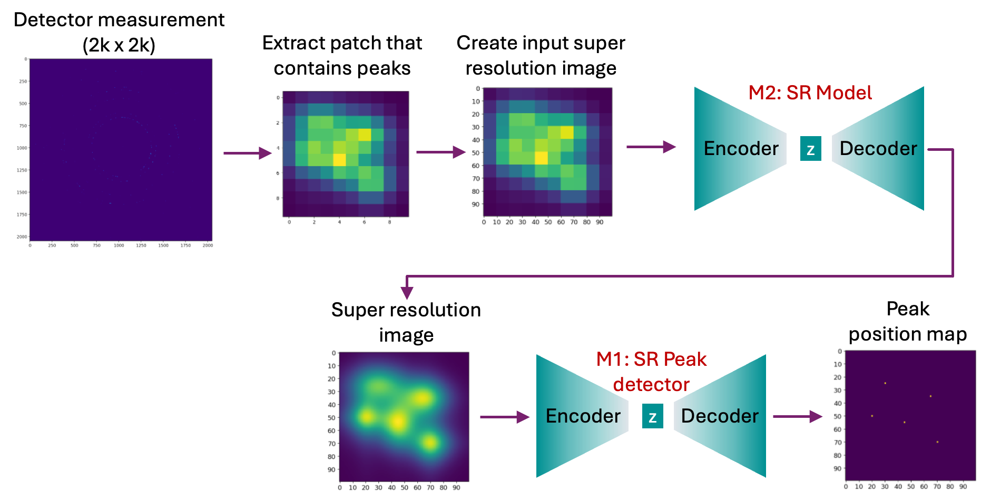
HEDM : Detecting overlapping peaks

Slide 7
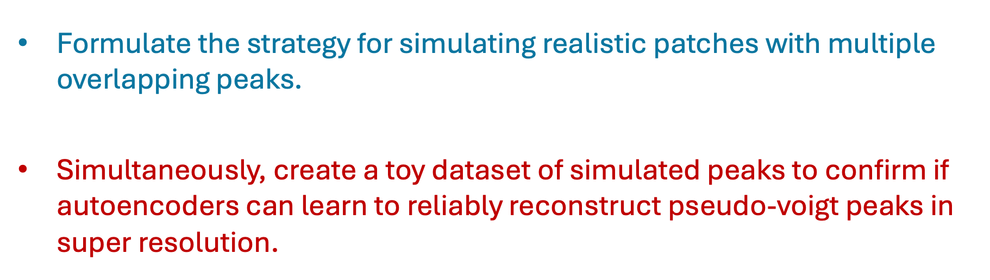
HEDM : Detecting overlapping peaks
What’s next !

Slide 8
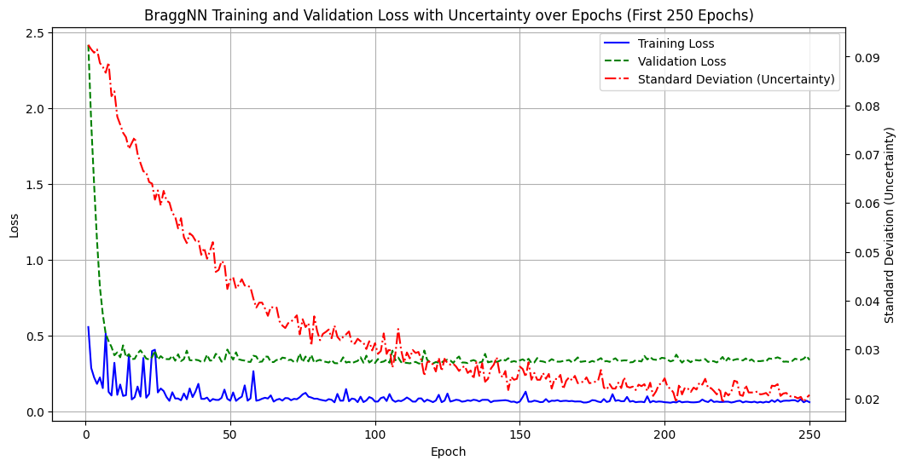
HEDM
Submitted a paper about the FRMR
  Three key tasks: initialization, model (re)training, and inference
  Used ALCF computing facilities and an edge computer server
Modified a new model for peak position prediction with uncertainty quantification (LDRD project)
  Converted some dense layers of BraggNN and ViT model to Bayesian Neural Network dense layers
  For BraggNN, results shows the uncertainty quantification prediction needs more epochs to converge than validation loss
Peak intensity normalization for rare-event detection
  Make invariant to peak intensity… only peak shape sensitive

